Slide 1
DATA 55100- Unsupervised Machine Learning
Dr. Sam Abuomar
DATA 55100- Unsupervised Machine Learning
Features-Part 2 Dr. Sam Abuomar
Dept. of Engineering, Computing, and Mathematical Sciences

Slide 2
Matlab Example
m1 = [ 1 1 1 ];
Cov1 = [ 2 0 rand() ; rand() 2 0 ; 0 0 9 ];
m2 = [ 1 10 10 ];
Cov2 = [ 2 rand() 0 ; rand() 2 0 ; 0 rand() 9 ];
DS1 = mvnrnd(m1,Cov1,100); DS2 = mvnrnd(m2,Cov2,100);
plot3(DS1(:,1),DS1(:,2),DS1(:,3),'or');
hold on;
plot3(DS2(:,1),DS2(:,2),DS2(:,3),'ob');
X = [ DS1 ; DS2 ];

Slide 3
Matlab Example
function r = mvnrnd(mu,sigma,cases);
[m1 n1] = size(mu);
c = max([m1 n1]); if m1 .* n1 ~= c
error('Mu must be a vector.'); end
[m n] = size(sigma); if m ~= n
error('Sigma must be square');
end
if m ~= c
error('The length of mu must equal the number of rows in sigma.'); end
[T p] = chol(sigma); if p ~= 0
error('Sigma must be a positive definite matrix.'); end
if m1 == c mu = mu'; end
mu = mu(ones(cases,1),:);
r = randn(cases,c) * T + mu;

Slide 4
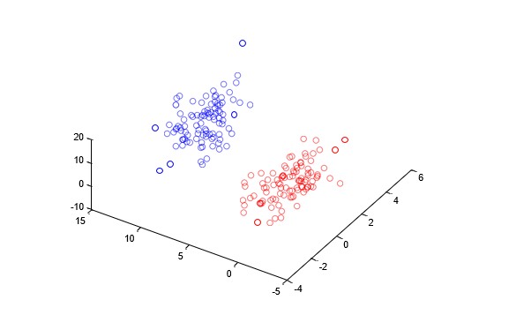
Matlab Example

Slide 5
Matlab Example
[EIGVEC EIGVAL] = eig(cov(X));
>> EIGVEC
EIGVEC =
0.9983 | -0.0382 | 0.0432
0.0029 | 0.7816 | 0.6238
-0.0575 | -0.6227 | 0.7804
>> EIGVAL
EIGVAL = 1.8729
0
0
0
0 5.3410
0 0 53.0361
>> EIGVAL(3,3) / sum(diag(EIGVAL))
ans =
0.8803
>> (EIGVAL(3,3)+EIGVAL(2,2)) / sum(diag(EIGVAL))
ans =
0.9689

Slide 6
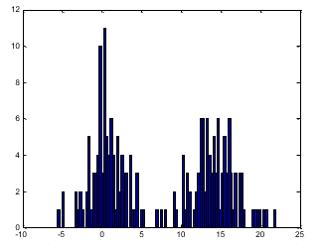
Matlab Example
XT = [];
for i=1:200
XT(i,1) = X(i,:) * EIGVEC(:,3);
end hist(XT,100)

Slide 7
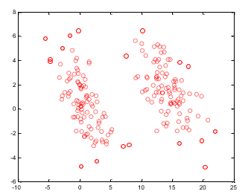
Matlab Example
XT = [];
for i=1:200
XT(i,1) = X(i,:) * EIGVEC(:,3);
XT(i,2) = X(i,:) * EIGVEC(:,2);
end plot(XT(:,1),XT(:,2),'or');

Slide 8
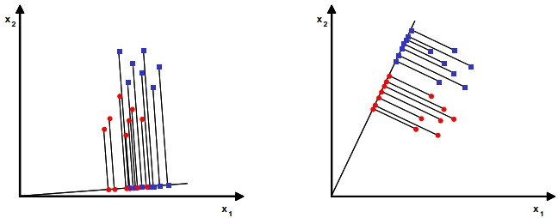
Linear Discriminate Analysis (LDA)
LDA seeks to reduce dimensionality while preserving as much as the class discriminatory information as possible

Slide 9
Linear Discriminate Analysis (LDA)

Slide 10
Linear Discriminate Analysis (LDA)

Slide 11
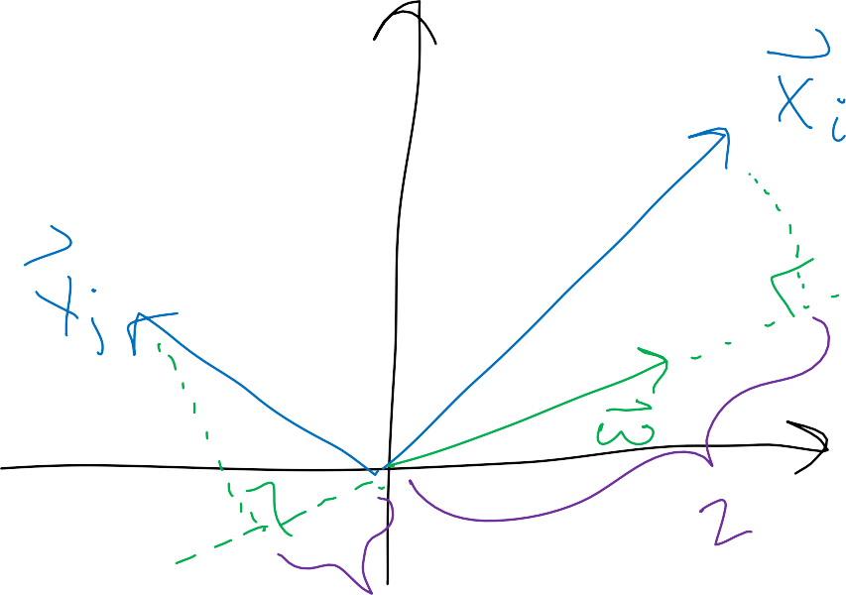
Linear Discriminate Analysis (LDA)

Slide 12
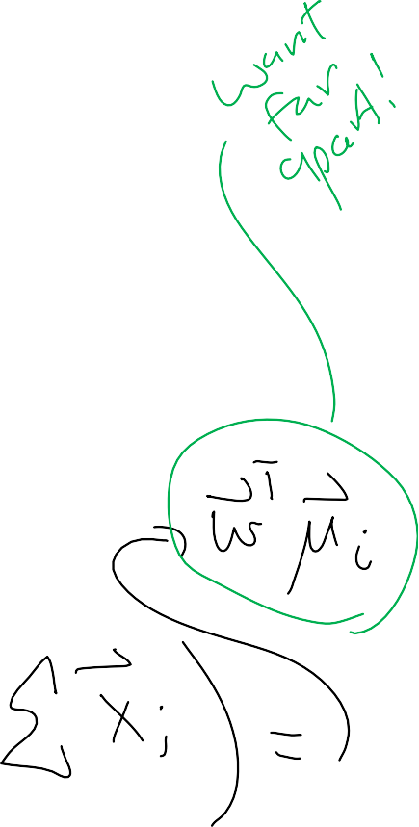
Linear Discriminate Analysis (LDA)

Slide 13
Linear Discriminate Analysis (LDA)

Slide 14
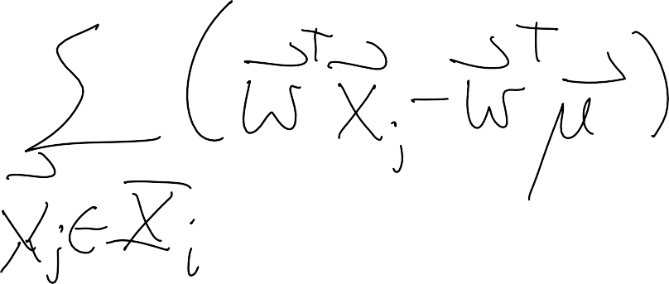
Linear Discriminate Analysis (LDA)

Slide 15
Linear Discriminate Analysis (LDA)

Slide 16
Linear Discriminate Analysis (LDA)

Slide 17
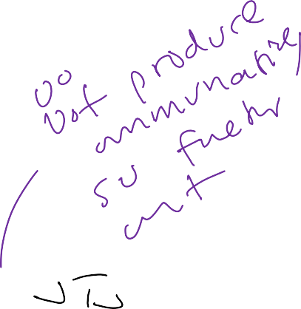
Linear Discriminate Analysis (LDA)

Slide 18
Linear Discriminate Analysis (LDA)

Slide 19
Linear Discriminate Analysis (LDA)

Slide 20
Linear Discriminate Analysis (LDA)

Slide 21
Linear Discriminate Analysis (LDA)

Slide 22
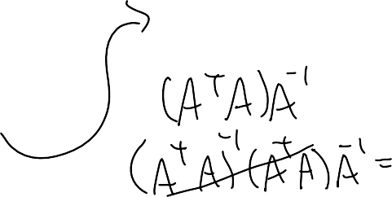
Linear Discriminate Analysis (LDA)

Slide 23
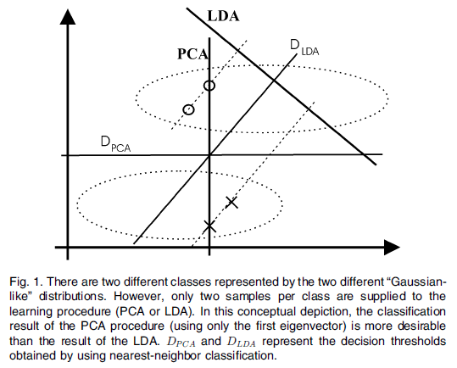
Linear Discriminate Analysis (LDA)
Martinez, A. M.; Kak, A. C. (2001). "PCA versus LDA". IEEE Transactions on Pattern Analysis and Machine Intelligence 23 (2): 228–233. doi:10.1109/34.908974

